Slide 1

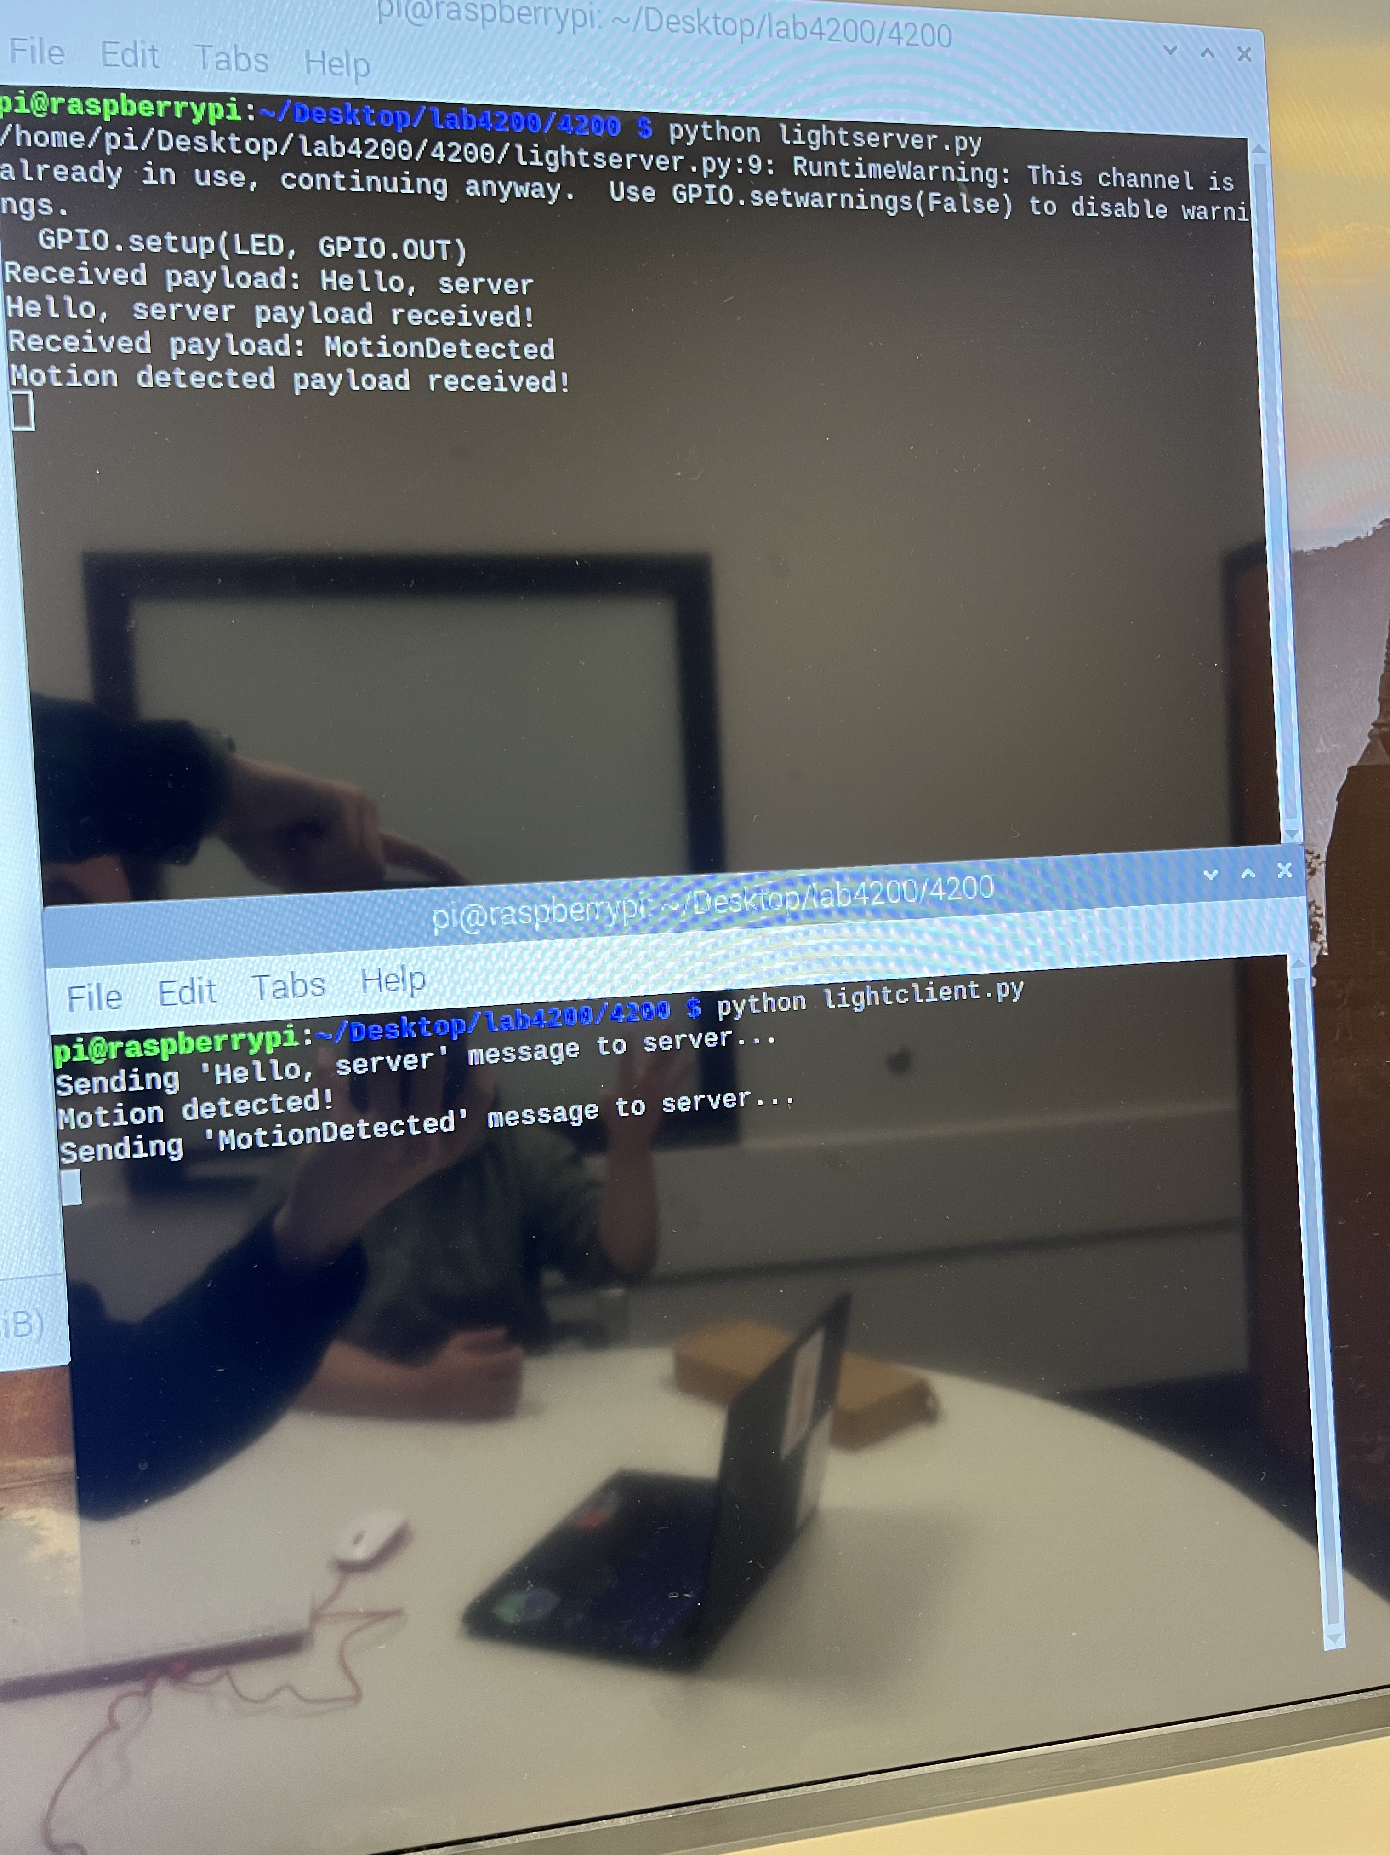
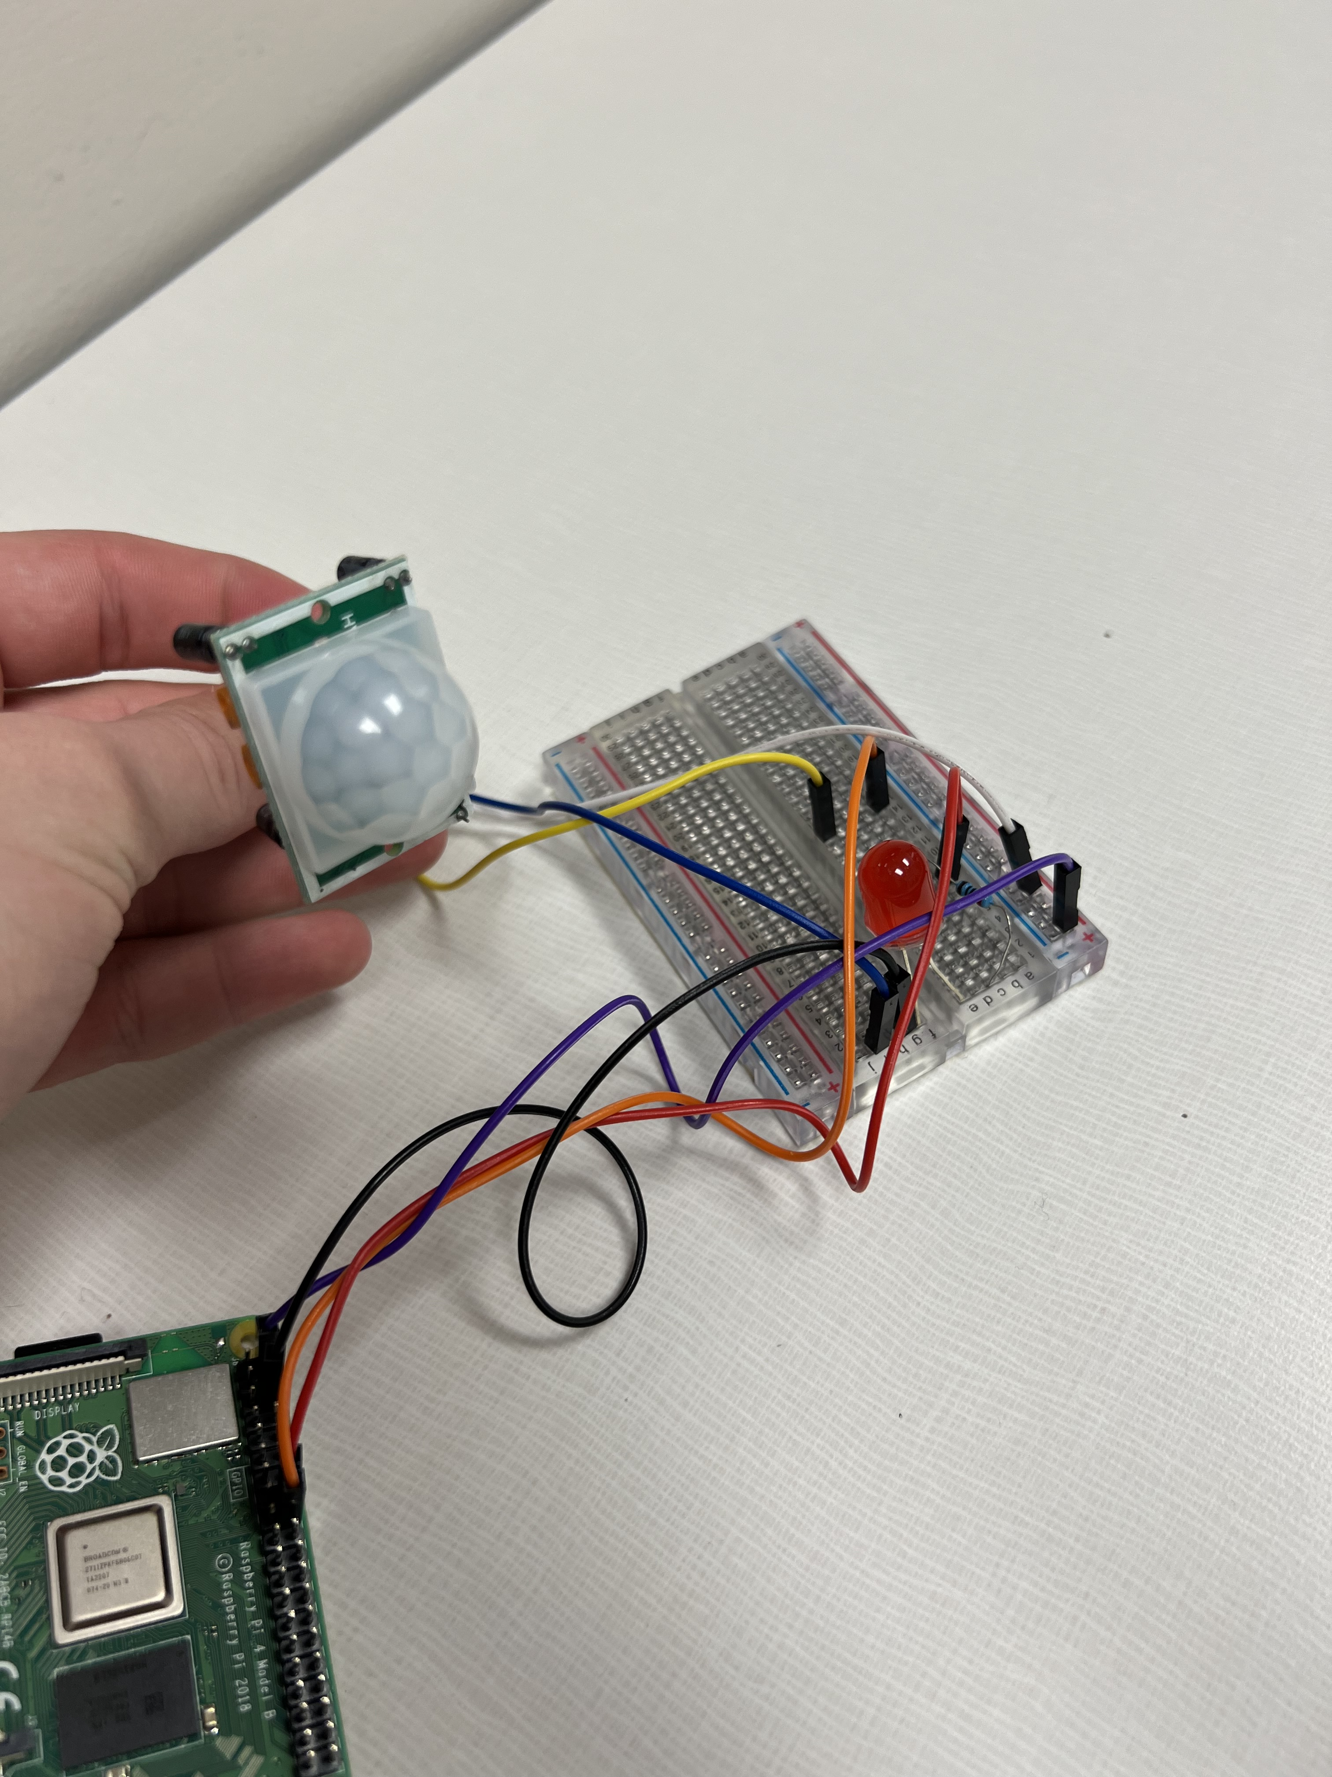
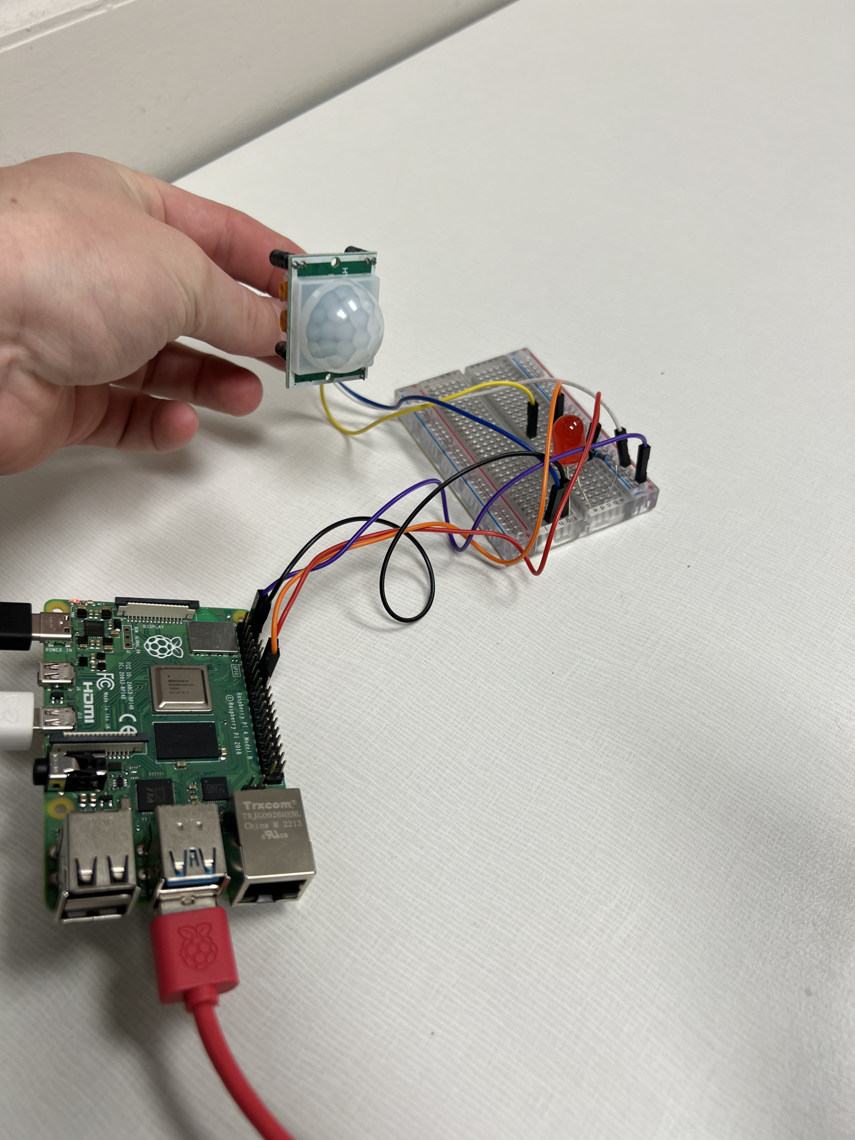
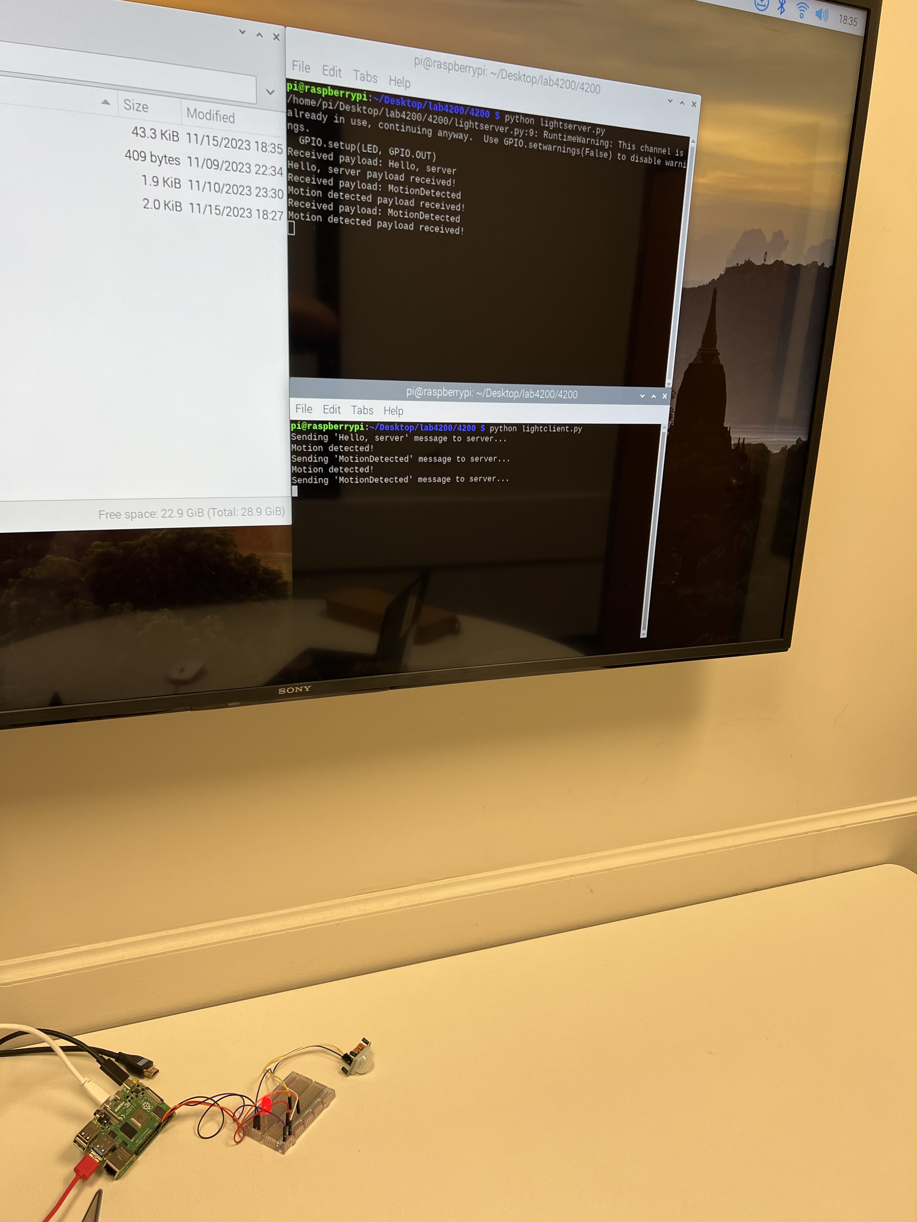
Detect a Person
Sam Staggs, Jonathan Leonard, Kevin Pathana: Computer Science, CSC 4200 – Computer Networks
Goal of this Project
Group: Sam Staggs, Jonathan Leonard, Kevin Pathana
The goal of this project was to develop two python scripts that communicated with each other to blink an LED. The way we did this was by taking a raspberry pi and settings up a PIR with an LED on a breadboard, coding two programs named “lightserver.py” and “lightclient.py”, and then having those programs communicate and send packets back and forth to detect motion.
Layout of Pi and Device
How
The following image shows the two scripts interacting with each other.
Lightserver.py lets the user know the the PIR and LED locations are in use.
Lightclient.py sends a “Hello, server” message to the lightserver.py, which then receives the message and lets the user know by saying “Hello, server payload received”
Lightclient.py then sends a ”MotionDetected” message once motion is detected by the PIR
Steps to Build
Setup raspberry pi, power, HDMI from pi to TV, pi to keyboard/mouse.
Wired a breadboard into the pi.
Setup an LED with a resistor, connect that to the pi.
Setup a PIR (Infrared Sensor) to the breadboard and from the breadboard to the pi.
Wrote a test program to make sure that the PIR and LED functioned first, LED being 23 and PIR being 24.
Wrote a script called “lightserver.py” that receives payloads from another script, the server itself doesn’t send out any payloads it just reads them.
Wrote a script called “lightclient.py” that sends payloads to the server, one indicating server connection and the other indicating the detection of motion.
Ran the script in two separate terminals testing functionality by adjusting the potentiometer and the sensitivity, then giving it motion to turn on the light.
Why
We did this experiment to see if it was even possible.
We were curious how far we could take scripting in terms of networking and communication.
It’s fun to software physically communicate with hardware through scripting.
Results
After much debugging, we finally figured out how to make the two scripts communicate.
Our initial thought process to create a dummy program that tested the two devices properly came in handy because it told us that devices themselves worked BEFORE we started writing the scripts.
Both scripts communicate with each other and send the proper messages.
Lightclient constantly sends a “Hello, server” message to ensure that the server exists, but it doesn’t spam the console with print statements.
Lightserver constantly waits for a connection.
Lightserver receives all commands without spamming print statements.
The LED blinks for approximately 2 seconds after a “MotionDetected” signal is received.
Closing the scripts is as easy as hitting Ctrl+C, and once that is done they exit gracefully with a ”Closing” message.
Where
When setting this up, we initially thought we would have to do this in a dark room.
It turns out all we had to do was point the PIR towards a wall and wave our hand in front to make it blink the LED

